Slide 1

Database Systems
Department of Computer Science
Chungbuk National University
Jong Yun LEE

Slide 2
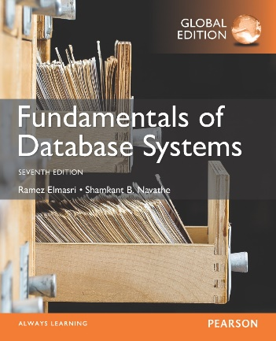
CHAPTER 2: Database System Concepts and Architecture

Slide 3
Introduction

Slide 4
Outline
Data Models and Their Categories
History of Data Models
Schemas, Instances, and States
Three-Schema Architecture
Data Independence
DBMS Languages and Interfaces
Database System Utilities and Tools
Centralized and Client-Server Architectures
Classification of DBMSs

Slide 5
Data Models, Schemas, and Instances

Slide 6
Data Models
Data Model:
A set of concepts to describe the structure of a database, the operations for manipulating these structures, and certain constraints that the database should obey.
Data Model Structure and Constraints:
Constructs are used to define the database structure
Constructs typically include elements (and their data types) as well as groups of elements (e.g. entity, record, table), and relationships among such groups
Constraints specify some restrictions on valid data; these constraints must be enforced at all times

Slide 7
Data Models (continued)
Data Model Operations:
These operations are used for specifying database retrievals and updates by referring to the constructs of the data model.
Operations on the data model may include basic model operations (e.g. generic insert, delete, update) and user-defined operations (e.g. compute_student_gpa, update_inventory)

Slide 8
Categories of Data Models
Conceptual (high-level, semantic) data models:
Provide concepts that are close to the way many users perceive data.
(Also called entity-based or object-based data models.)
Physical (low-level, internal) data models:
Provide concepts that describe details of how data is stored in the computer. These are usually specified in an ad-hoc manner through DBMS design and administration manuals
Implementation (representational) data models:
Provide concepts that fall between the above two, used by many commercial DBMS implementations (e.g. relational data models used in many commercial systems).
Self-Describing Data Models:
Combine the description of data with the data values. Examples include XML, key-value stores and some NOSQL systems.

Slide 9
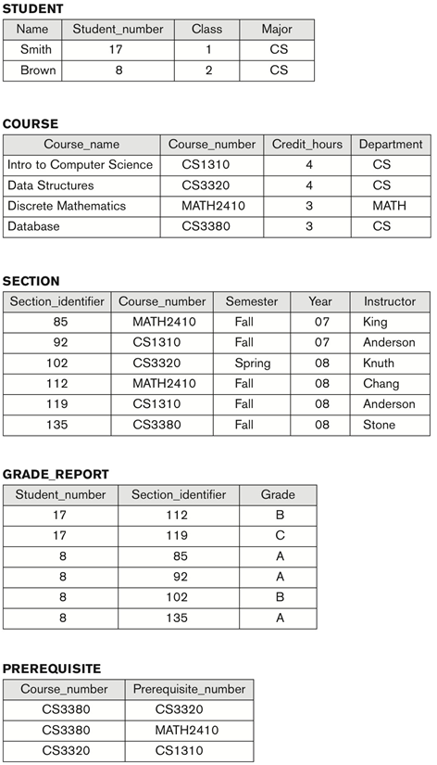
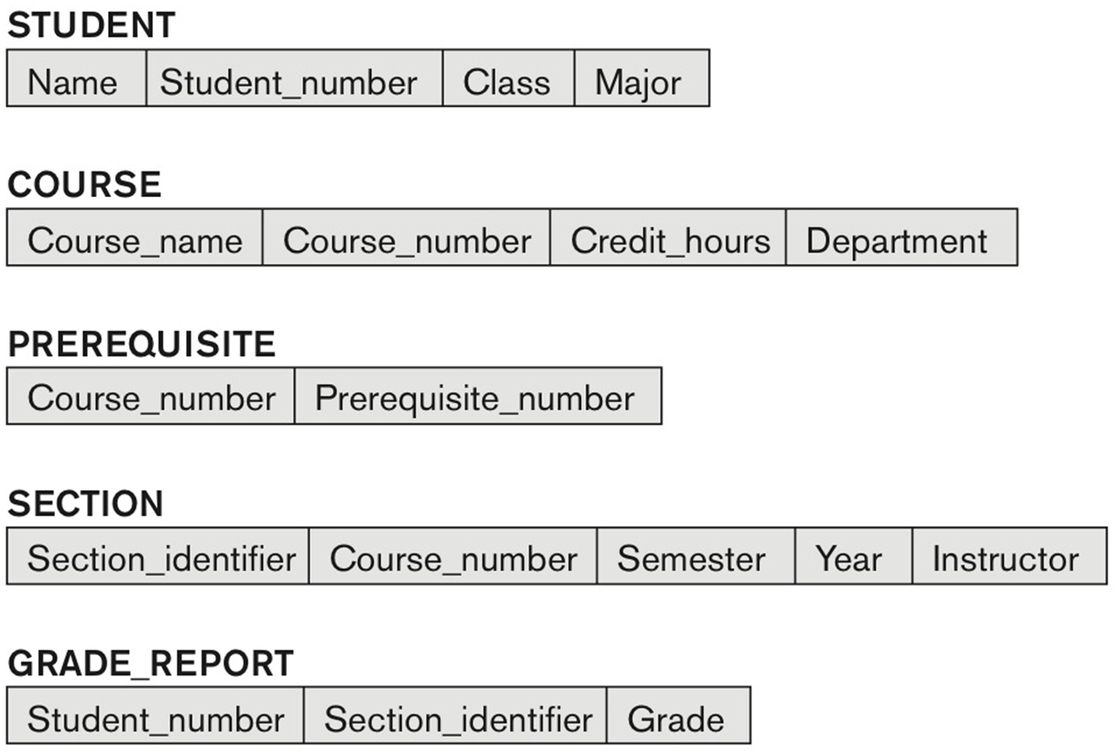
Schemas versus Instances
Database Schema:
The description of a database.
Includes descriptions of the database structure, data types, and the constraints on the database.
Schema Diagram:
An illustrative display of (most aspects of) a database schema.
A database that stores student and course information
Schema diagram for the database

Slide 10
Schemas versus Instances
Schema Construct:
A component of the schema or an object within the schema, e.g., STUDENT, COURSE.
Database State:
The actual data stored in a database at a particular moment in time. This includes the collection of all the data in the database.
Also called database instance (or occurrence or snapshot).
The term instance is also applied to individual database components, e.g. record instance, table instance, entity instance

Slide 11
Database Schema vs. Database State
Database State:
Refers to the content of a database at a moment in time.
Initial Database State:
Refers to the database state when it is initially loaded into the system.
Valid State:
A state that satisfies the structure and constraints of the database.

Slide 12
Database Schema vs. Database State (continued)
Distinction
The database schema changes very infrequently.
The database state changes every time the database is updated.
Schema is also called intension.
State is also called extension.

Slide 13
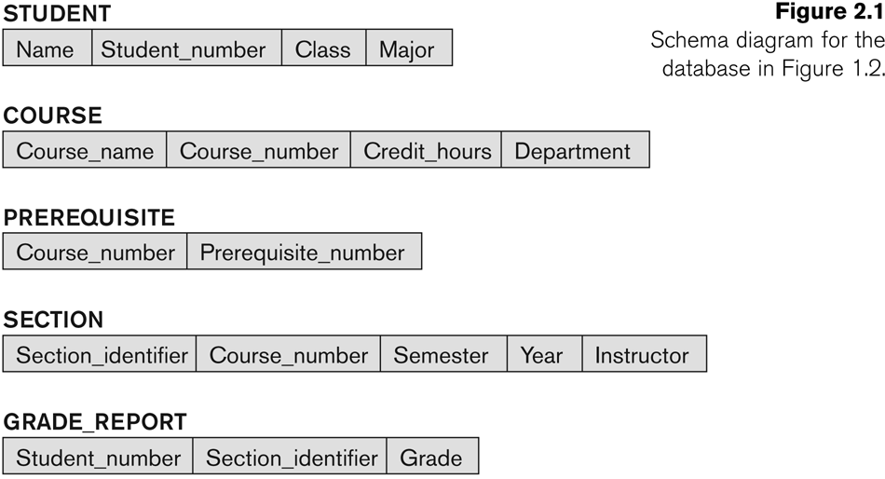
Example of a Database Schema

Slide 14
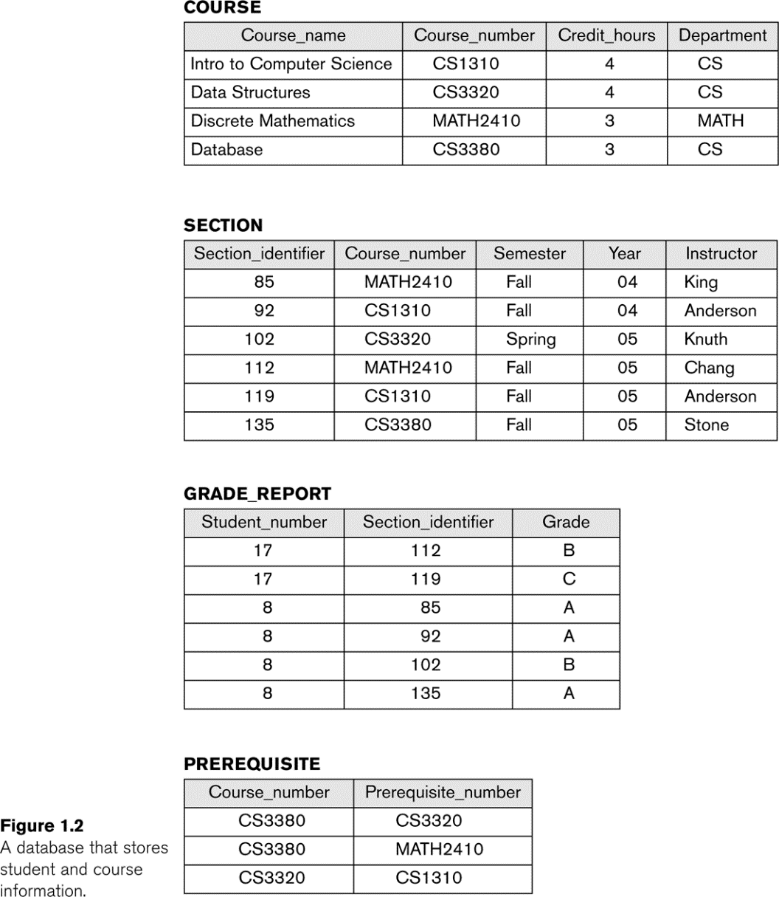
Example of a database state

Slide 15
Three-Schema Architecture and Data Independence

Slide 16
Three-Schema Architecture
Proposed to support DBMS characteristics of:
Program-data independence.
Support of multiple views of the data.
Not explicitly used in commercial DBMS products, but has been useful in explaining database system organization

Slide 17
Three-Schema Architecture
Defines DBMS schemas at three levels:
Internal schema at the internal level to describe physical storage structures and access paths (e.g indexes).
Typically uses a physical data model.
Conceptual schema at the conceptual level to describe the structure and constraints for the whole database for a community of users.
Uses a conceptual or an implementation data model.
External schemas at the external level to describe the various user views.
Usually uses the same data model as the conceptual schema.

Slide 18
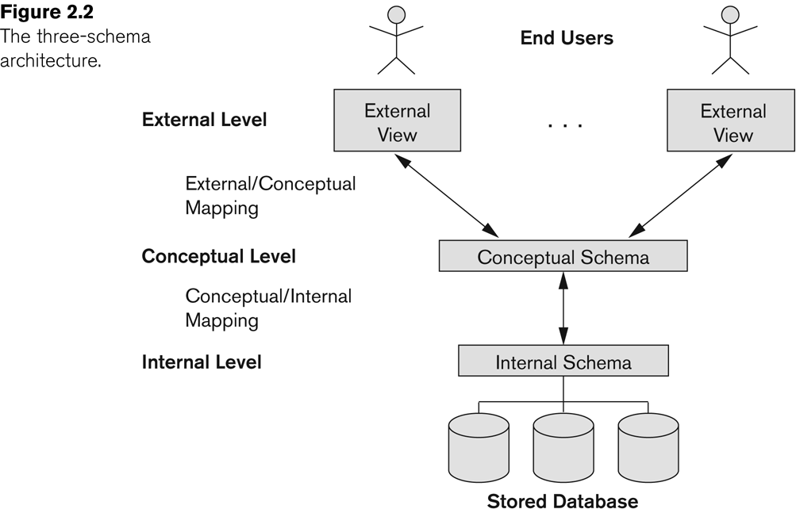
Three-Schema Architecture

Slide 19
Three-Schema Architecture
Mappings among schema levels are needed to transform requests and data.
Programs refer to an external schema, and are mapped by the DBMS to the internal schema for execution.
Data extracted from the internal DBMS level is reformatted to match the user’s external view (e.g. formatting the results of an SQL query for display in a Web page)

Slide 20
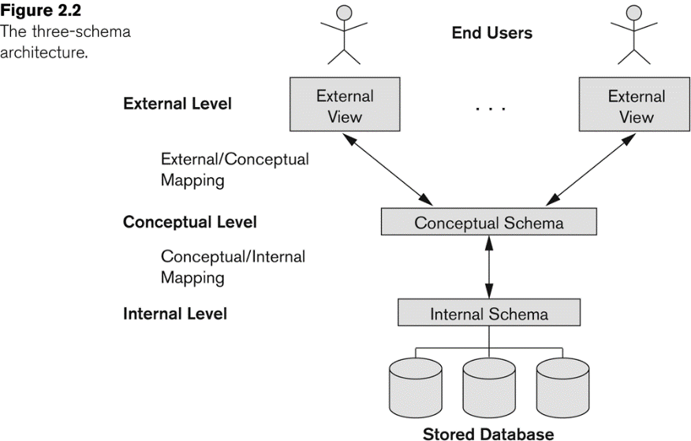
Data Independence
Logical Data Independence:
The capacity to change the conceptual schema without having to change the external schemas and their associated application programs.
Physical Data Independence:
The capacity to change the internal schema without having to change the conceptual schema.
For example, the internal schema may be changed when certain file structures are reorganized or new indexes are created to improve database performance

Slide 21
Data Independence (continued)
When a schema at a lower level is changed, only the mappings between this schema and higher-level schemas need to be changed in a DBMS that fully supports data independence.
The higher-level schemas themselves are unchanged.
Hence, the application programs need not be changed since they refer to the external schemas.

Slide 22
Database Languages and Interfaces

Slide 23
DBMS Languages
Data Definition Language (DDL)
Data Manipulation Language (DML)
High-Level or Non-procedural Languages: These include the relational language SQL: (Interactive Query Language)
May be used in a standalone way or may be embedded in a programming language
Low Level or Procedural Languages: (Embedded Language)
These must be embedded in a programming language

Slide 24
DBMS Languages
Data Definition Language (DDL):
Used by the DBA and database designers to specify the conceptual schema of a database.
In many DBMSs, the DDL is also used to define internal and external schemas (views).
In some DBMSs, separate storage definition language (SDL) and view definition language (VDL) are used to define internal and external schemas.
SDL is typically realized via DBMS commands provided to the DBA and database designers

Slide 25
DBMS Languages
Data Manipulation Language (DML):
Used to specify database retrievals and updates
DML commands (data sublanguage) can be embedded in a general-purpose programming language (host language), such as COBOL, C, C++, or Java.
A library of functions can also be provided to access the DBMS from a programming language
Alternatively, stand-alone DML commands can be applied directly (called a query language).

Slide 26
Types of DML
High Level or Non-procedural Language:
For example, the SQL relational language
Are “set”-oriented and specify what data to retrieve rather than how to retrieve it.
Also called declarative languages.
Low Level or Procedural Language:
Retrieve data one record-at-a-time;
Constructs such as looping are needed to retrieve multiple records, along with positioning pointers.
iterator

Slide 27
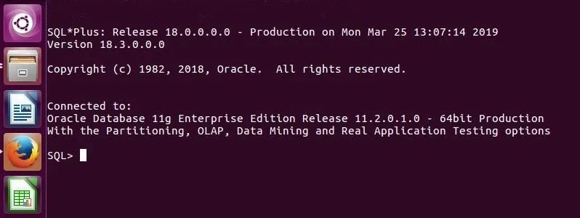
DBMS Interfaces
Stand-alone query language interfaces
Example: Entering SQL queries at the DBMS interactive SQL interface (e.g. SQL*Plus in ORACLE)
Programmer interfaces for embedding DML in programming languages
User-friendly interfaces
Menu-based, forms-based, graphics-based, etc.
Mobile Interfaces: interfaces allowing users to perform transactions using mobile apps

Slide 28
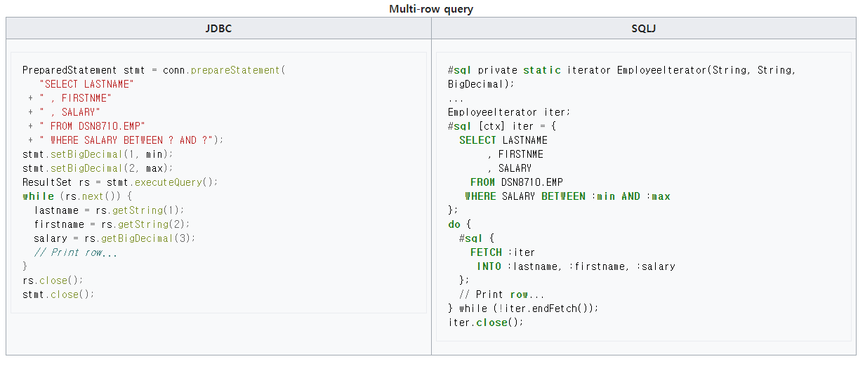
DBMS Programming Language Interfaces
Embedded Approach: e.g embedded SQL (for C, C++, etc.), SQLJ (for Java)
Procedure Call Approach: e.g. JDBC for Java, ODBC (Open Database Connectivity) for other programming languages as API’s (application programming interfaces)

Slide 29
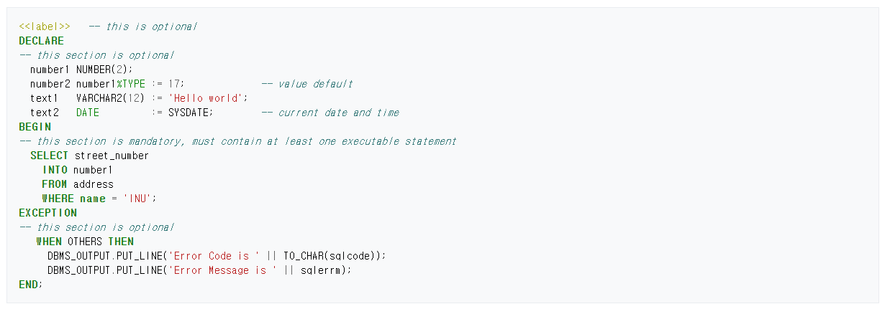
DBMS Programming Language Interfaces
Database Programming Language Approach: e.g. ORACLE has PL/SQL, a programming language based on SQL; language incorporates SQL and its data types as integral components
Scripting Languages: PHP (client-side scripting) and Python (server-side scripting) are used to write database programs.

Slide 30
User-Friendly DBMS Interfaces
Menu-based (Web-based), popular for browsing on the web
Forms-based, designed for naïve users used to filling in entries on a form
Graphics-based
Point and Click, Drag and Drop, etc.
Specifying a query on a schema diagram
Natural language: requests in written English
Combinations of the above:
For example, both menus and forms used extensively in Web database interfaces

Slide 31
Other DBMS Interfaces
Natural language: free text as a query
Speech : Input query and Output response
Web Browser with keyword search
Parametric interfaces, e.g., bank tellers using function keys.
Interfaces for the DBA:
Creating user accounts, granting authorizations
Setting system parameters
Changing schemas or access paths

Slide 32
The Database System Environment

Slide 33
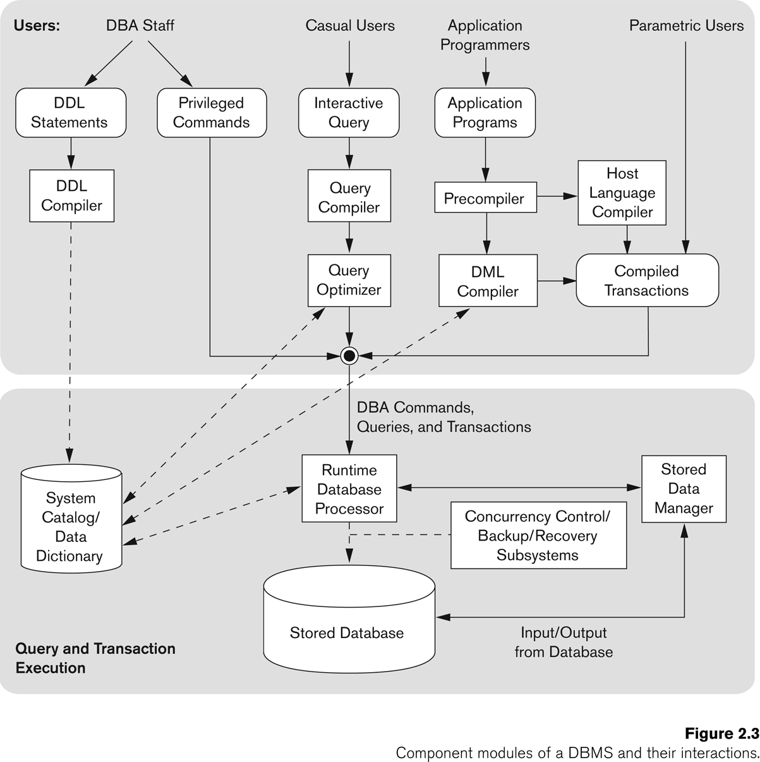
Typical DBMS Component Modules
Runtime Database
Query Processor

Slide 34
Database System Utilities
To perform certain functions such as:
Loading data stored in files into a database. Includes data conversion tools.
Backing up the database periodically on tape.
Reorganizing database file structures.
Performance monitoring utilities.
Report generation utilities.
Other functions, such as sorting, user monitoring, data compression, etc.

Slide 35
Other Tools
Data dictionary / repository:
Used to store schema descriptions and other information such as design decisions, application program descriptions, user information, usage standards, etc.
Active data dictionary is accessed by DBMS software and users/DBA.
Passive data dictionary is accessed by users/DBA only.

Slide 36
Other Tools
Application Development Environments and CASE (computer-aided software engineering) tools:
Examples:
PowerBuilder (Sybase)
JBuilder (Borland)
JDeveloper 10G (Oracle)

Slide 37
Centralized and Client/Server Architectures for DBMS

Slide 38
Centralized and Client-Server DBMS Architectures
Centralized DBMS:
Combines everything into single system including- DBMS software, hardware, application programs, and user interface processing software.
User can still connect through a remote terminal – however, all processing is done at centralized site.

Slide 39
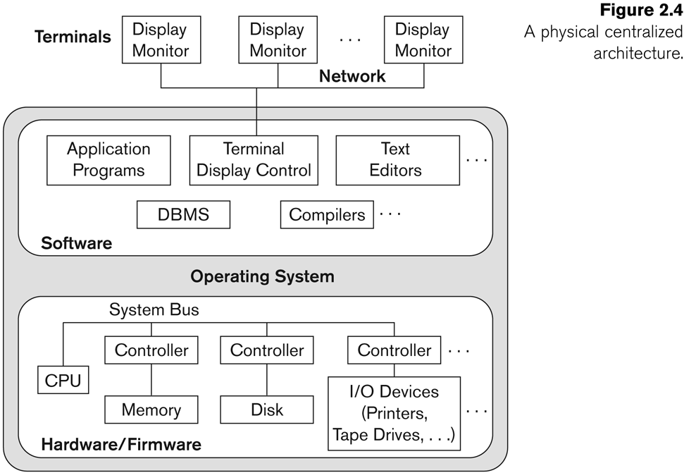
A Physical Centralized Architecture

Slide 40
Basic 2-tier Client-Server Architectures
Specialized Servers with Specialized functions
Print server
File server
DBMS server
Web server
Email server
Clients can access the specialized servers as needed

Slide 41
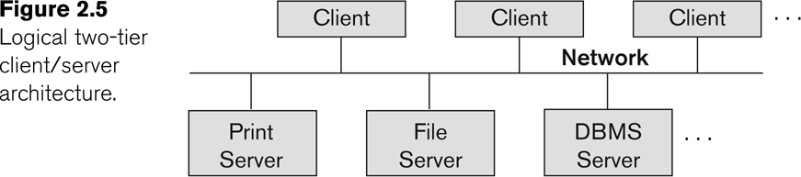
Logical two-tier client server architecture
Web
Server

Slide 42
Clients
Provide appropriate interfaces through a client software module to access and utilize the various server resources.
Clients may be diskless machines or PCs or Workstations with disks with only the client software installed.
Connected to the servers via some form of a network.
(LAN: local area network, wireless network, etc.)

Slide 43
DBMS Server
Provides database query and transaction services to the clients
Relational DBMS servers are often called SQL servers, query servers, or transaction servers
Applications running on clients utilize an Application Program Interface (API) to access server databases via standard interface such as:
ODBC: Open Database Connectivity standard
JDBC: for Java programming access

Slide 44
Two Tier Client-Server Architecture
Client and server must install appropriate client module and server module software for ODBC or JDBC
A client program may connect to several DBMSs, sometimes called the data sources.
In general, data sources can be files or other non-DBMS software that manages data.
See Chapter 10 for details on Database Programming

Slide 45
Three Tier Client-Server Architecture
Common for Web applications
Intermediate Layer called Application Server or Web Server:
Stores the web connectivity software and the business logic part of the application used to access the corresponding data from the database server
Acts like a conduit for sending partially processed data between the database server and the client.
Three-tier Architecture Can Enhance Security:
Database server only accessible via middle tier
Clients cannot directly access database server
Clients contain user interfaces and Web browsers
The client is typically a PC or a mobile device connected to the Web

Slide 46
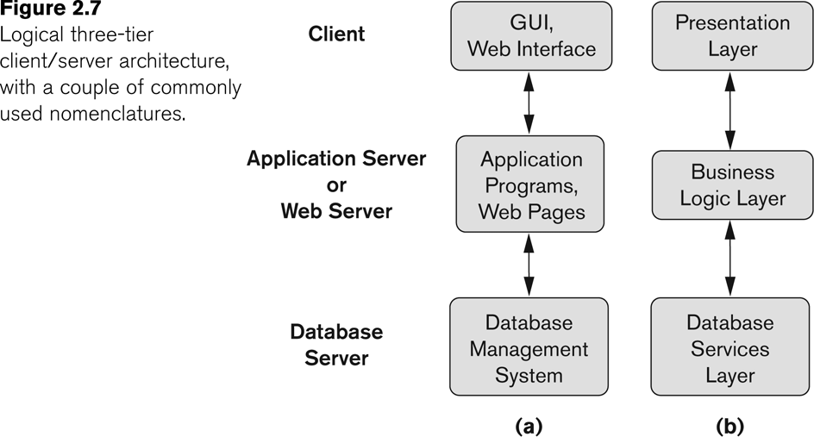
Three-tier client-server architecture

Slide 47
Classification of Database Management Systems

Slide 48
Classification of DBMSs
Based on the data model used
Legacy: Network, Hierarchical.
Currently Used: Relational, Object-oriented, Object-relational
Recent Technologies: Key-value storage systems, NOSQL systems: document based, column-based, graph-based and key-value based. Native XML DBMSs.
Other classifications
Single-user (typically used with personal computers) vs. multi-user (most DBMSs).
Centralized (uses a single computer with one database) vs. distributed (multiple computers, multiple DBs)

Slide 49
Variations of Distributed DBMSs (DDBMSs)
Homogeneous DDBMS
Heterogeneous DDBMS
Federated or Multidatabase Systems
Participating Databases are loosely coupled with high degree of autonomy.
Distributed Database Systems have now come to be known as client-server based database systems because:
They do not support a totally distributed environment, but rather a set of database servers supporting a set of clients.

Slide 50
Cost considerations for DBMSs
Cost Range: from free open-source systems to configurations costing millions of dollars
Examples of free relational DBMSs: MySQL, PostgreSQL, others
Commercial DBMS offer additional specialized modules, e.g. time-series module, spatial data module, document module, XML module
These offer additional specialized functionality when purchased separately
Sometimes called cartridges (e.g., in Oracle) or blades
Different licensing options: site license, maximum number of concurrent users (seat license), single user, etc.

Slide 51
Other Considerations
Type of access paths within database system
E.g.- inverted indexing based (ADABAS is one such system).Fully indexed databases provide access by any keyword (used in search engines)
General Purpose vs. Special Purpose
E.g.- Airline Reservation systems or many others-reservation systems for hotel/car etc. Are special purpose OLTP (Online Transaction Processing Systems)

Slide 52
History of Data Model

Slide 53
History of Data Models (Additional Material)
Network Model
Hierarchical Model
Relational Model
Object-oriented Data Models
Object-Relational Models

Slide 54
Network Model
The first network DBMS was implemented by Honeywell in 1964-65 (IDS System).
Adopted heavily due to the support by CODASYL (Conference on Data Systems Languages) (CODASYL - DBTG report of 1971).
Later implemented in a large variety of systems - IDMS (Cullinet - now Computer Associates), DMS 1100 (Unisys), IMAGE (H.P. (Hewlett-Packard)), VAX -DBMS (Digital Equipment Corp., next COMPAQ, now H.P.).

Slide 55
Network Model
Advantages:
Network Model is able to model complex relationships and represents semantics of add/delete on the relationships.
Can handle most situations for modeling using record types and relationship types.
Language is navigational; uses constructs like FIND, FIND member, FIND owner, FIND NEXT within set, GET, etc.
Programmers can do optimal navigation through the database.

Slide 56
Network Model
Disadvantages:
Navigational and procedural nature of processing
Database contains a complex array of pointers that thread through a set of records.
Little scope for automated “query optimization”

Slide 57
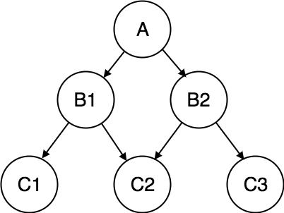
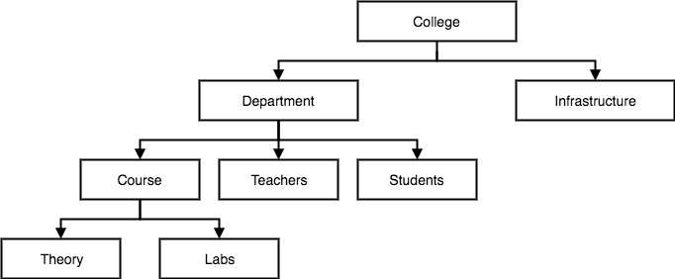
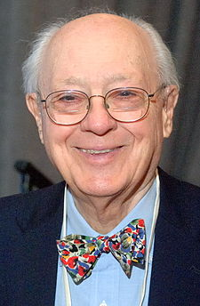
Historical Development of Database Technology
Early Database Applications:
The Hierarchical and Network Models were introduced in mid 1960s and dominated during the seventies.
A bulk of the worldwide database processing still occurs using these models, particularly, the hierarchical model using IBM’s IMS system.
Charles William Bachman III (Born on December 11, 1924 – July 13, 2017) was an American computer scientist.
Hierarchical Model
Network Model
a top-down structure
supports one-to-one and
one-to-many relationships
supports one-to-one
one-to-many
and many-to-many relationships
problem was the inability to support ad hoc queries

Slide 58
Hierarchical Data Model
Initially implemented in a joint effort by IBM and North American Rockwell around 1965. Resulted in the IMS family of systems.
IBM’s IMS product had (and still has) a very large customer base worldwide
Hierarchical model was formalized based on the IMS system
Other systems based on this model: System 2k (SAS inc.)

Slide 59
Hierarchical Model
Advantages:
Simple to construct and operate
Corresponds to a number of natural hierarchically organized domains, e.g., organization (“org”) chart
Language is simple:
Uses constructs like GET, GET UNIQUE, GET NEXT, GET NEXT WITHIN PARENT, etc.
Disadvantages:
Navigational and procedural nature of processing
Database is visualized as a linear arrangement of records
Little scope for "query optimization"

Slide 60
Relational Model
Proposed in 1970 by E.F. Codd (IBM), first commercial system in 1981-82.
Now in several commercial products (e.g. DB2, ORACLE, MS SQL Server, SYBASE, INFORMIX).
Several free open source implementations, e.g. MySQL, PostgreSQL
Currently most dominant for developing database applications.
SQL relational standards: SQL-89 (SQL1), SQL-92 (SQL2), SQL-99, SQL3, …
Chapters 5 through 11 describe this model in detail

Slide 61
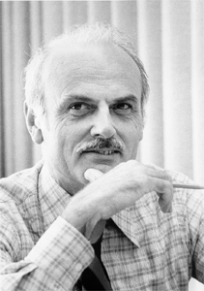
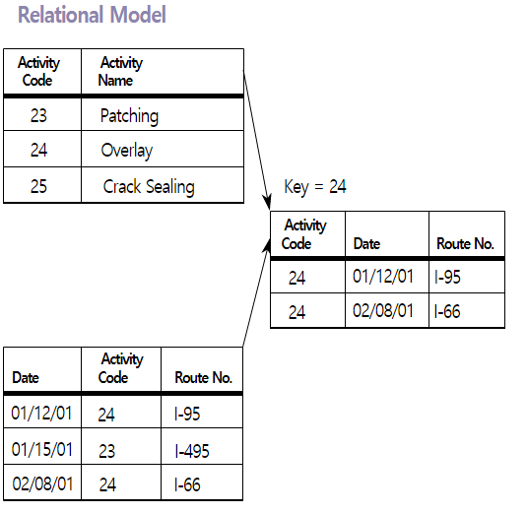
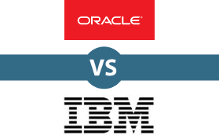
Historical Development of Database Technology
Relational Model based Systems:
Relational model was originally introduced in 1970, was heavily researched and experimented within IBM Research and several universities.
Relational DBMS Products emerged in the early 1980s.
Edgar Frank "Ted" Codd (19 August 1923 – 18 April 2003) was an English computer scientist who, while working for IBM, invented the relational model for database management, the theoretical basis for relational databases and relational database management systems.

Slide 62
Object-oriented Data Models
Several models have been proposed for implementing in a database system.
One set comprises models of persistent O-O Programming Languages such as C++ (e.g., in OBJECTSTORE or VERSANT), and Smalltalk (e.g., in GEMSTONE).
Additionally, systems like O2, ORION (at MCC - then ITASCA), IRIS (at H.P.- used in Open OODB).
Object Database Standard: ODMG-93, ODMG-version 2.0, ODMG-version 3.0.
Chapter 12 describes this model.

Slide 63
Object-Relational Models
The trend to mix object models with relational was started with Informix Universal Server.
Relational systems incorporated concepts from object databases leading to object-relational.
Exemplified in the versions of Oracle, DB2, and SQL Server and other DBMSs.
Current trend by Relational DBMS vendors is to extend relational DBMSs with capability to process XML, Text and other data types.
The term “Object-relational” is receding in the marketplace.

Slide 64
Chapter Summary
Data Models and Their Categories
Schemas, Instances, and States
Three-Schema Architecture
Data Independence
DBMS Languages and Interfaces
Database System Utilities and Tools
Database System Environment
Centralized and Client-Server Architectures
Classification of DBMSs
History of Data Models

